Slide 1

经济学原理：第四讲
蔡洪滨
北京大学光华管理学院

Slide 2
Ch. 4: Supply and Demand: Elasticity and Applications
A. Price Elasticity of Demand and Supply
B. Applications to Major Economic Issues

Slide 3
A. Price Elasticityof Supply and Demand
Not only are we concerned with what direction price and quantity will move when the market conditions change, but we are concerned about how much they change
Elasticity gives a way to measure by how much a variable will change with the change in another variable
Specifically, it gives the percentage change in one variable resulting from a one percent change in another

Slide 4
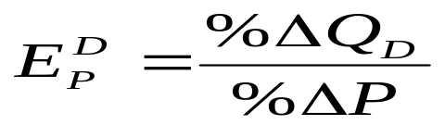
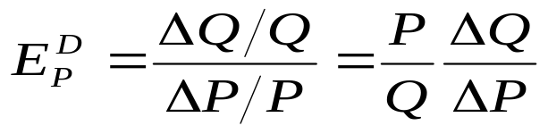
Price Elasticity of Demand
Measures the sensitivity of quantity demanded to
price changes
  It measures the percentage change in the quantity demanded of a good that results from a one percent change in price
  The percentage change in a variable is the absolute change in the variable divided by the original level of the variable. Thus, elasticity can also be written as:

Slide 5
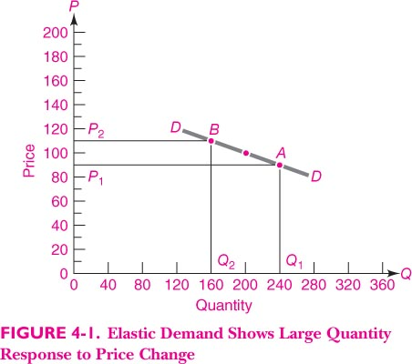

Slide 6
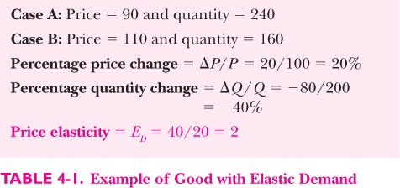

Slide 7
Price Elasticity of Demand
Usually a negative number, but we focus on absolute value
When |E_{P}| > 1, the good is price elastic:
  |%ΔQ| > |%ΔP|
When |E_{P}| <＝1, the good is unit elastic:
  |%ΔQ| =|% ΔP|
When |E_{P}| < 1, the good is price inelastic:
  |%ΔQ| < |% ΔP|

Slide 8
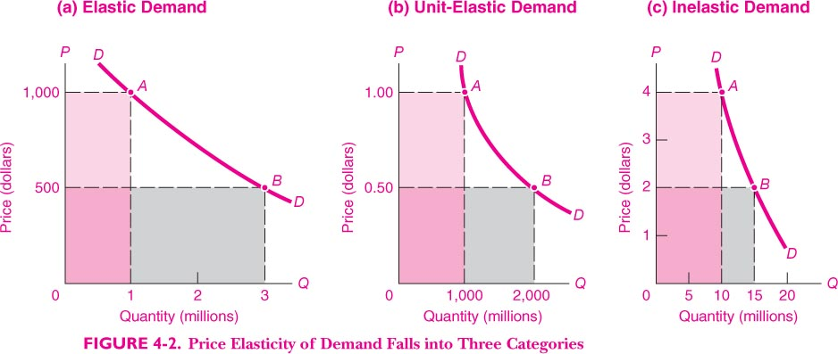

Slide 9
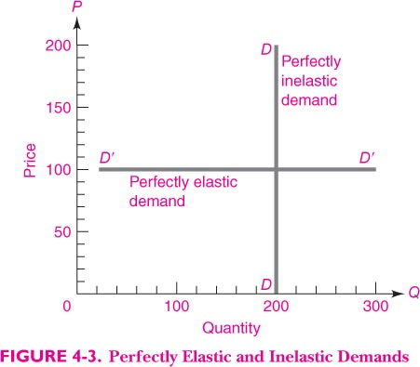

Slide 10
Price Elasticity of Demand
The determinants of price elasticity of demand
  If a good has many close substitutes, demand is more likely to be price elastic.
  Compared with necessary goods, demand for luxury goods is price elastic.
  If consumers have more time to adjust, demand is more likely to be price elastic.

Slide 11

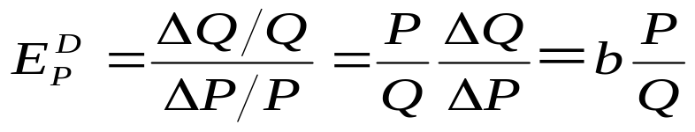
Price Elasticity of Linear Demand
Given a linear demand curve:
  Elasticity depends on slope and on the values of P and Q
  The top portion of demand curve is elastic
    Price is high and quantity small
  The bottom portion of demand curve is inelastic
    Price is low and quantity high

Slide 12
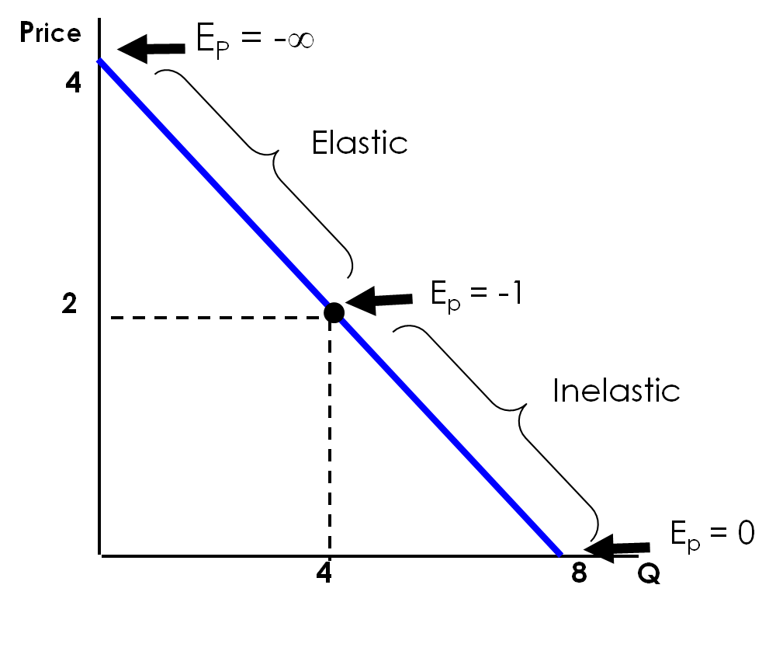
Price Elasticity of Demand
Demand Curve
Q = 8 – 2P

Slide 13
Price Elasticity and Revenue
Businessmen want to know whether raising prices will raise or lower revenues
Total revenues = P ×Q(P)
When demand is price-inelastic, a price decreases reduces total revenues
When demand is price-elastic, a price decreases increase total revenues
Price discrimination is based on different price elasticities of different customers

Slide 14
The Paradox of the Bumper Harvest
The good weather and bumper crop have lowered farmers’ incomes
How come? The answer lies in the elasticity of demand for foodstuffs
The demand for basic food products tend to be price inelastic
The increase in supply arising from an abundant harvest lowers the price, and the farmers’ income as well
Reducing food production can actually help farmers

Slide 15
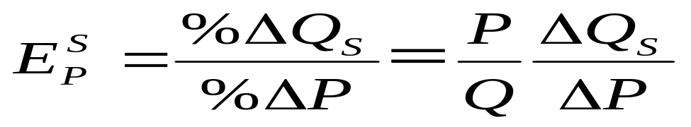
Price Elasticity of Supply
Measures the sensitivity of quantity supplied given a change in price
  Measures the percentage change in quantity supplied resulting from a 1 percent change in price

Slide 16
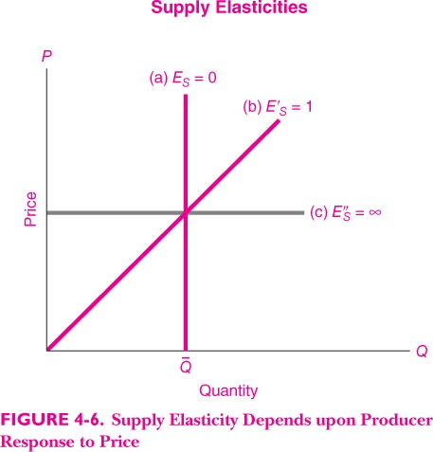

Slide 17
Determinants of Supply Elasticity
Price elasticity of supply will be higher if inputs can be easily adjusted.
Price elasticity of supply is smaller in the short run than in the long run.

Slide 18
B1. Long Run Relative Decline of Agriculture
A typical modernization process consists of industrialization, urbanization and the increasing productivity of agriculture.
In this process, the relative size of the agricultural sector shrinks in terms of labor share and output share.
Also, the relative price of agricultural products declines.
The reason: both demand and supply shift, but demand for food is less elastic.
Question: why does food price in China increase recently?

Slide 19
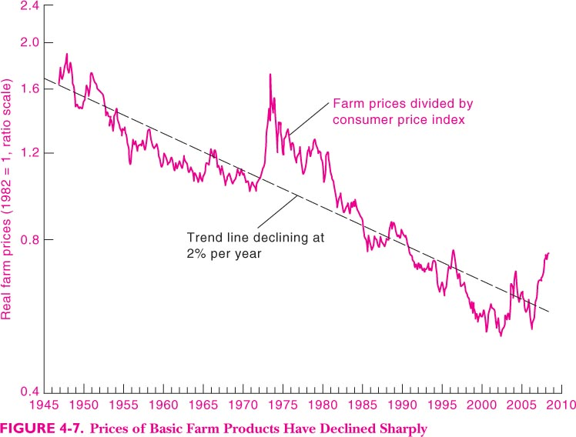

Slide 20
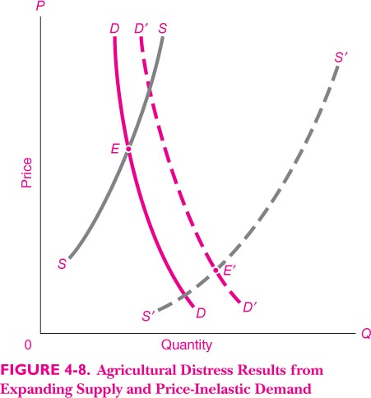

Slide 21
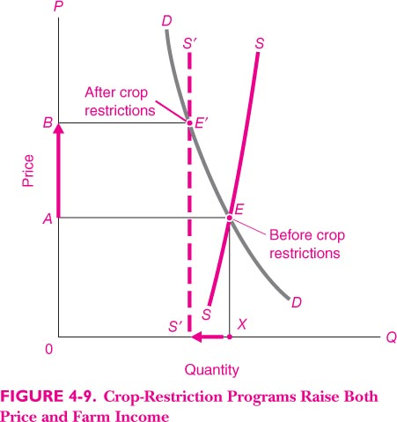

Slide 22
B2. Tax Incidence
General consumption tax: sales tax, with the purpose to generate tax revenue
Governments often tax consumption of certain commodities: gas, cigarettes, alcohol, imported goods, luxury tax…; in order to generate revenue and sometimes discourage consumption
Who (consumers or producers) eventually pays the tax?
Is it effective to reduce consumption (e.g., curb smoking)?
Both questions rely on the relative elasticity of demand and supply.

Slide 23
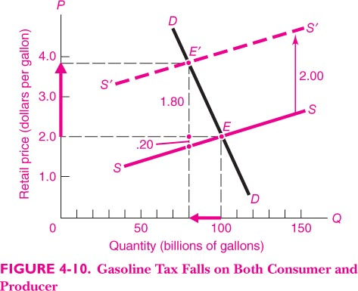

Slide 24
B3. Effects of Price Controls
Price controls: government regulation sets the price above or below the equilibrium price
  Price Ceilings: control overheated prices of certain commodities (e.g., gas). This leads to excess demand – shortage.
  Price Floors: support producers of certain products (e.g., farmers) or labor (minimum wage), This leads to excess supply – surplus.
How effective are these policies in achieving their goals depends on the demand and supply elasticity.

Slide 25
The Minimum-Wage Controversy
Theoretically the rise in the minimum wage (a price floor of the market price for labor) leads to a rise in unemployment and a decrease in employment of low-skilled workers.
Evidence from the United States indicates that a 10% increase in the minimum wage would reduce employment of teenagers by 1-3%
The impact on adult employment is even smaller
The effects on employment, unemployment, and income for different group of people
How about China? The “New Labor Contract Law”.

Slide 26
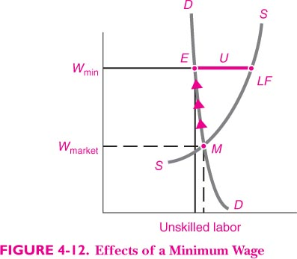

Slide 27
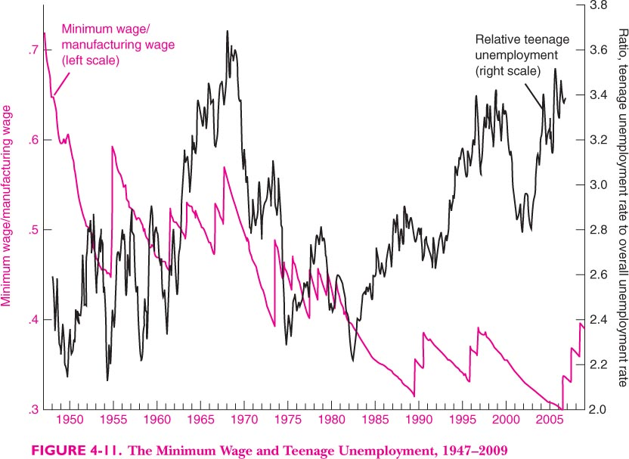

Slide 28
Effects of Price Ceilings
Price ceilings above equilibrium price create excess demand.
Excess demand sometimes takes the form of queues
  Lines at gas stations during 1974 shortage
Sometimes allocate by coupons and rationing (China’s central planning era: 票证时代）
  Natural gas shortage of the mid ’70’s
Producers typically lose, but some consumers gain. Some consumers lose.
Car License Allocation: Beijing and Shanghai

Slide 29
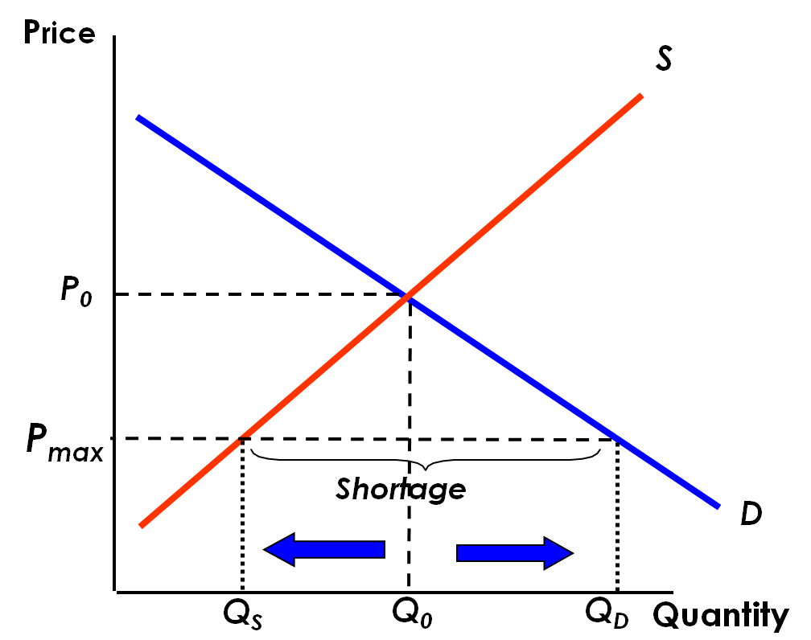
Effects of Price Controls
Price is regulated to be no higher than P_{max}
Quantity supplied falls and quantity demanded increases
A shortage results

Slide 30
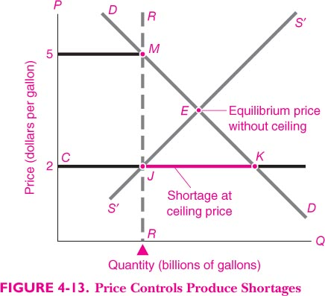

Slide 31
Reminder:
  Review Chapter 4
  Preview Chapter 5
  Thank you!

